Slide 1

Transforming P&G through Digital Technologies
MGMT 683 Technology-Driven Business Group Project
December 2024
Amy Fischbach
Ananth Mohan
Shashank Sridhar

Slide 2
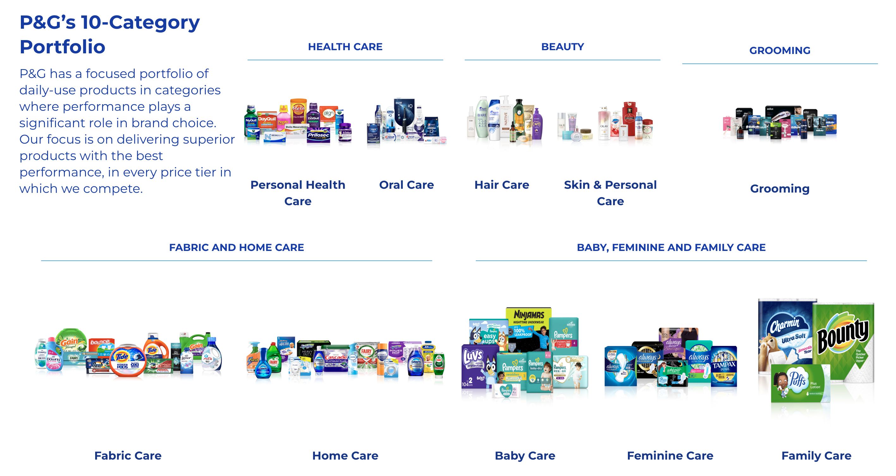
What is P&G (Proctor & Gamble)
Established in 1837, P&G specializes in a wide range of products ranging from personal health, beauty to family and home care and their product portfolio evolved over time

Slide 3
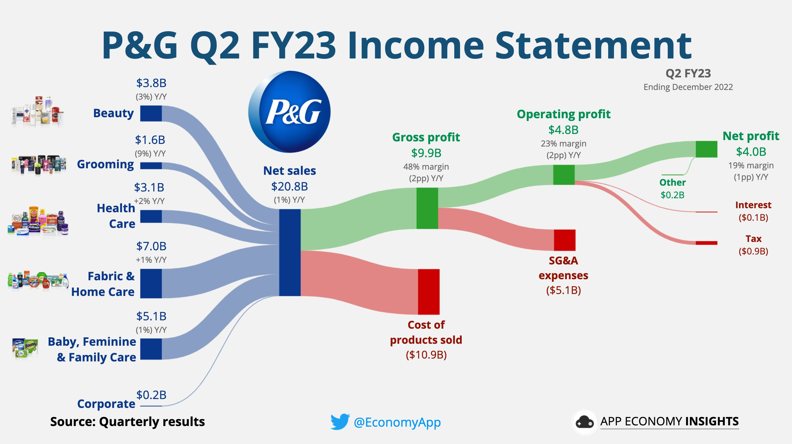
Profit Model
P&G has a net quarterly sales of ~21B, with ~33% of revenue come from Fabric & Home Care. They have a profit margin of ~20% with their main expense bring Cost of Product Sold
Profit Margin
Sources of Revenue
Major Cost

Slide 4






P&G’s Other Business Model Aspects
Value Proposition and Go-To-Market Strategies push P&G towards success.
Value Proposition​
Go-to-Market Strategies
Innovation and Product Development: Investing in research and development to introduce new and improved products
Product Superiority: High-quality, reliable products.
Global Localization: Adapting products and marketing strategies to align with local cultures and preferences in various markets
Packaging: Advanced product designs and functional packaging
Consumer & Retail Value: Competitive pricing, superior in-store execution.
Emotional Storytelling: Utilizing compelling narratives in marketing campaigns to build strong emotional connections with consumers
Notes:
https://www.pginvestor.com/company-strategy/
https://us.pg.com/annualreport2023/pg-strategy/ https://us.pg.com/blogs/pg-2023-annual-report-integrated-strategy-series/

Slide 5

P&G’s Value Chain
P&G has a linear sequential value chain, whereby they use distributors and retailers as channels
R&D
Sales
Marketing
Finance
Global consumers seeking quality and innovative daily-use products
Distributors
Sourcing and Procurement
Consumers
Retailers
Product Flow
Money Flow

Slide 6
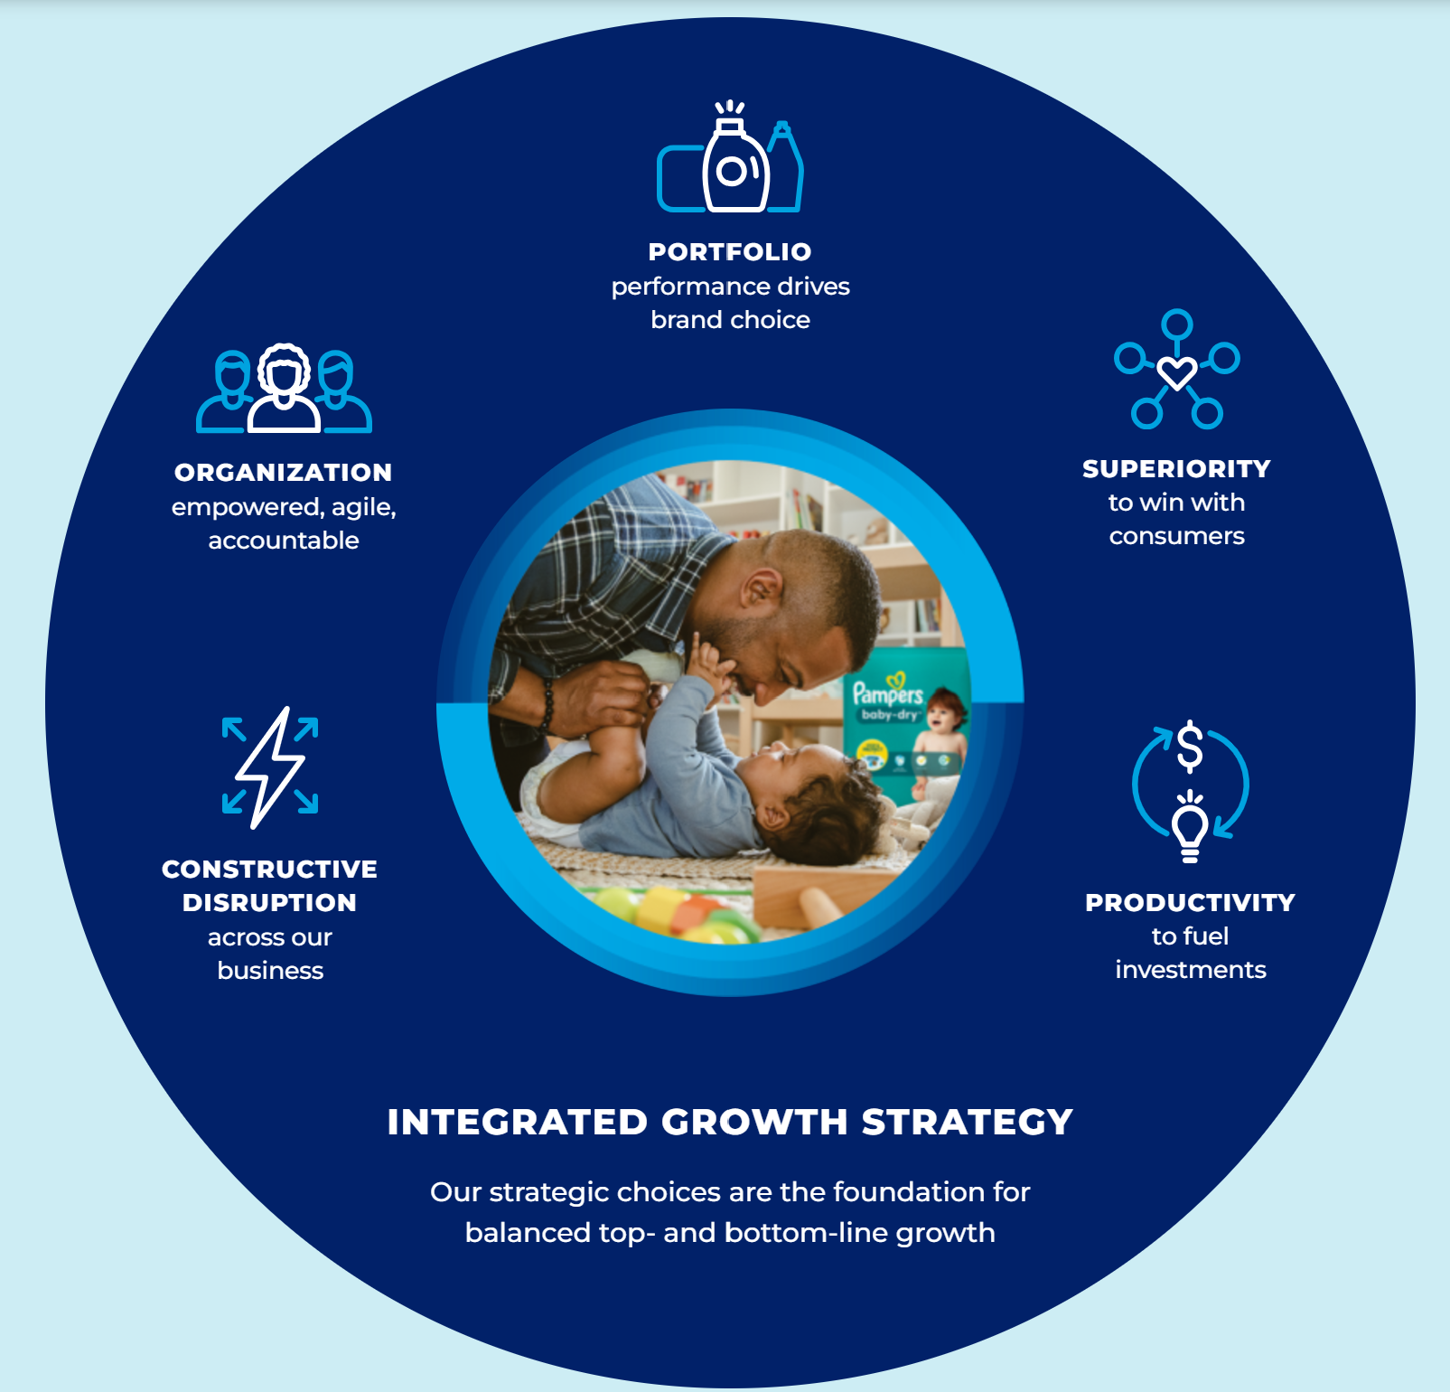
Superiority in All Aspects of Value Chain
P&G aims to grow steadily through focusing on 5 Key Factors:​
​
Focused Portfolio​
Highlight their 10 product categories for brand superiority​
Product Superiority​
Better packaging, brand communication, etc.​
Productivity Improvement​
Improve costs/cash to invest in more opportunities​
Constructive Disruption​
Adjusting relationships across current value chain to keep up with industry​
Agile Organization​
Adjust structure to meet needs of market​
Notes:
https://www.pginvestor.com/company-strategy/
https://us.pg.com/annualreport2023/pg-strategy/ https://us.pg.com/blogs/pg-2023-annual-report-integrated-strategy-series/

Slide 7
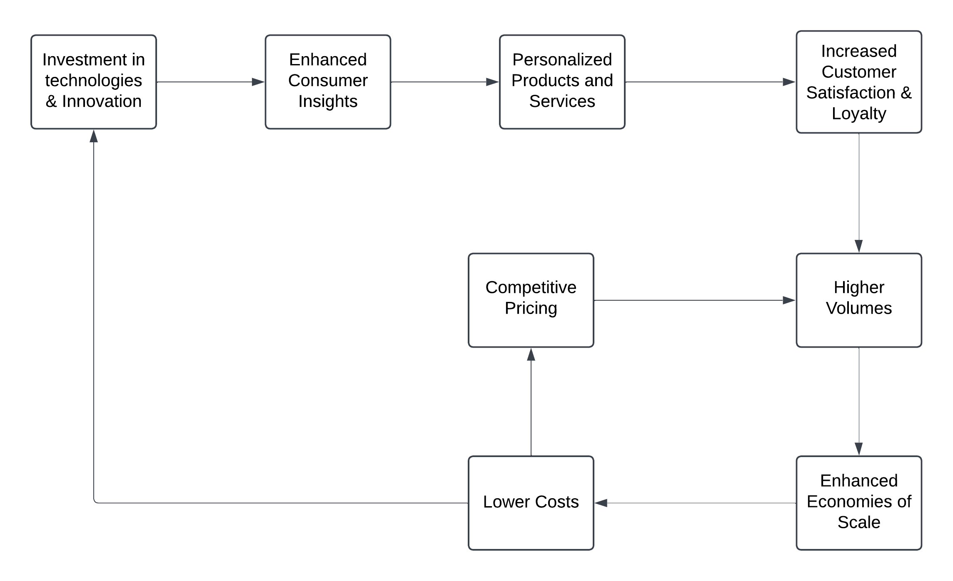
Logic of the Business – Virtuous Cycle
P&G’s primary goal is to be the most consumer-centric FMCG company by leveraging digital technologies to deliver personalized products and services, achieve operational excellence, and ensure sustained growth and profitability

Slide 8
Technology implementation for Business Model improvements
With $2B in technology spend, P&G integrates technology across key players in their value chain.
Idea
Examples
Supply Chain innovation with automated modeling and simulation, reduces costs in unit economics​
Geotagging, proprietary algorithms, Digital Twin, AI analysis, SKU trimming​
Using AI sensors track products and customer usage, and partners with new tech companies to push R&D​
Modeling and simulation techniques to find new ingredients for products faster​
Tech at P&G​
($2B in Spend)​
AI modeling to predict emerging trends utilizing customer data for Marketing​
Digital tools to improve search show up and marketing campaigns​
Pushing e-commerce growth and digital strategy to help with Sales​
Algorithms to target the right price point and product sizes​
Notes:
https://www.globaldata.com/store/report/procter-and-gamble-company-enterprise-tech-analysis/
https://us.pg.com/blogs/keys-to-successful-digital-transformation/
https://www.cio.com/article/408351/pg-turns-to-ai-to-create-digital-manufacturing-of-the-future.html
https://consumergoods.com/how-pg-supply-chain-30-pilots-are-slashing-costs-and-increasing-productivity
https://consumergoods.com/pg-trimming-skus-part-collaborative-commerce-strategy
https://us.pg.com/blogs/100-years-of-pg-analytics-and-insights/

Slide 9
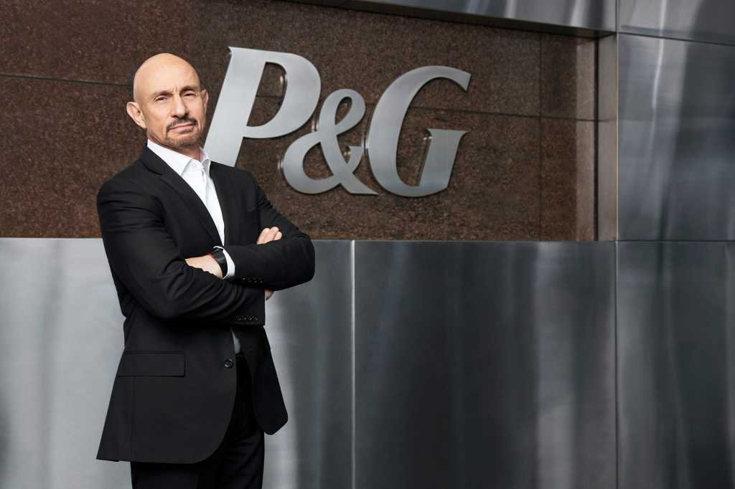
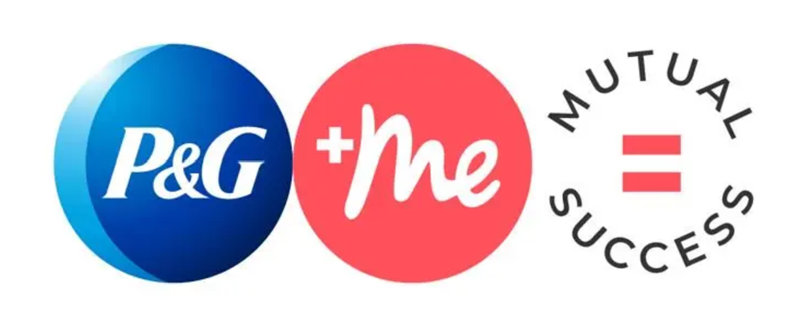
P&G CIO Vittorio Cretella Pushing for Talent and Technology
P&G uses AI within the organization to understand employee requirements
“Companies scaling AI face challenges in three categories: data, talent, and culture”​
Utilization of Talent Assessments help scan for best talent for the Employee Talent Equation​
Recommendation:​
Apply AI modeling/sensors to understand employee workplace needs and wants​
Notes:
https://deloitte.wsj.com/cio/procter-gamble-cio-everybody-must-own-the-digital-story-01674840235 https://www.cio.com/article/408351/pg-turns-to-ai-to-create-digital-manufacturing-of-the-future.html

Slide 10
Modernizing User Experiences
Adapting new technology to adjust consumer experience to align with consumer needs.
What? | How? | Why?
Personalization Through Data and AI | AI-driven skincare recommendations via Olay app Tailored subscription services like Pampers delivery based on baby growth stages | Improve product relevance, leading to increased customer loyalty and higher retention rates
Real-Time Engagement | Use chatbots and AI assistants to answer customer questions and assist with product selection | Improve trust, reducing cart abandonment rates, and increase customer satisfaction
Seamless Omnichannel Experiences | Consistency across online and offline channels - products browsed online are easily available in stores Unified loyalty programs and redeemable digital coupons | Convenient shopping experience, fostering trust and improving brand reliability
Augmented and Virtual Reality (AR/VR) | AR for visualizing product and its impact Virtual consultations for Pantene beauty products | Enhance the customer decision-making process to reduce uncertainty and increase customer confidence
Mobile Apps for Deeper Interaction | Track purchases and push personalized promotions Educate users on product use and sustainability programs. | Better tracking of purchases, and promoting sustainability, leading to long-term brand loyalty

Slide 11
Streamlining Processes
Optimize operations for efficiency, sustainability, and resilience through digital transformation.
What? | How? | Why?
Data-Driven Supply Chain | Use AI to optimize inventory management, demand forecasting, and route planning Implement tools like Digital Twins for end-to-end supply chain visibility | Reduce wastage, improve on-time deliveries, and adapt to market fluctuations.
Robotic Process Automation (RPA) | Automate repetitive tasks like invoice processing, order management, and HR workflows using RPA tools | Reduce human error, accelerate processes, and lower costs.
Smart Manufacturing and IoT | Digitize production facilities with IoT sensors to monitor and predict equipment health Implement predictive maintenance solutions | Reduce downtime, enhance productivity, lower operational costs.
Sustainability Monitoring | Use cloud platforms to track and analyze carbon footprints across the value chain using blockchain-enabled ledgers. | Meet regulatory requirements and enhance brand equity through transparent reporting.

Slide 12





How Competitors Are Leveraging Digital Innovations
While P&G maintains its leadership across most segments, competitors are pursuing digital transformation initiatives
Product Segment | Key Competitor | Competitor's Strengths
Health Care |  | Invests in digital health platforms and data analytics to enhance patient care and product development.
Beauty |  | Implement AI-powered tools to create hyper-personalized consumer experiences, thereby boosting brand engagement and sales
Grooming |  | Enhance e-commerce and digital marketing strategies to create a seamless omnichannel experience, as demonstrated by their partnership with Blue
Fabric and Home Care |  | Invests in smart packaging technology to enhance consumer experience and promote sustainability
Baby, Feminine, and Family Care |  | Prioritized business objectives in its digital transformation, implementing robotic process automation (RPA) to streamline supply chain and finance operations
Notes:
https://www.globaldata.com/store/report/procter-and-gamble-company-enterprise-tech-analysis/?utm_source=chatgpt.com

Slide 13


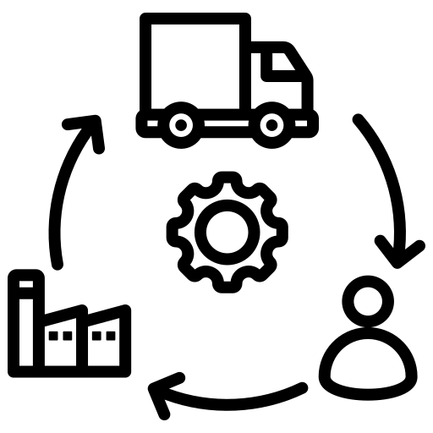
Successful Digital Transformation at P&G
"Innovation is ingrained in P&G’s culture, and over the years, we’ve seen a great level of success when we invite ideas from all corners of the business."— P&G Blog
Upskilling Our Workforce
Harnessing AI for Enhanced Efficiency & Creativity
Building a Future-Ready Supply Chain
Comprehensive upskilling programs across all departments foster innovation and agility.
Project Genie leverages AI to assist 800+ Customer Service Reps, reducing query processing times and enhancing consumer experience.
AI is embedded across functions to improve consumer experiences and deliver business value at scale.
Deployment of four proprietary generative AI platforms drives efficiency, decision-making, and product innovation.
Real-time data analytics, automation, and a “right the first time, every time” approach ensure superior product quality and operational efficiency.
Integration of detergent formulas into a core data lake allows rapid alternative formulation development, optimizing manufacturing based on material availability.
For over 185 years, P&G’s culture of innovation, paired with cutting-edge digital tools, has enabled it to stay at the forefront of consumer needs and market trends, ensuring sustained growth and leadership.

Slide 14
Thank You!

Slide 15
Appendix

Slide 16
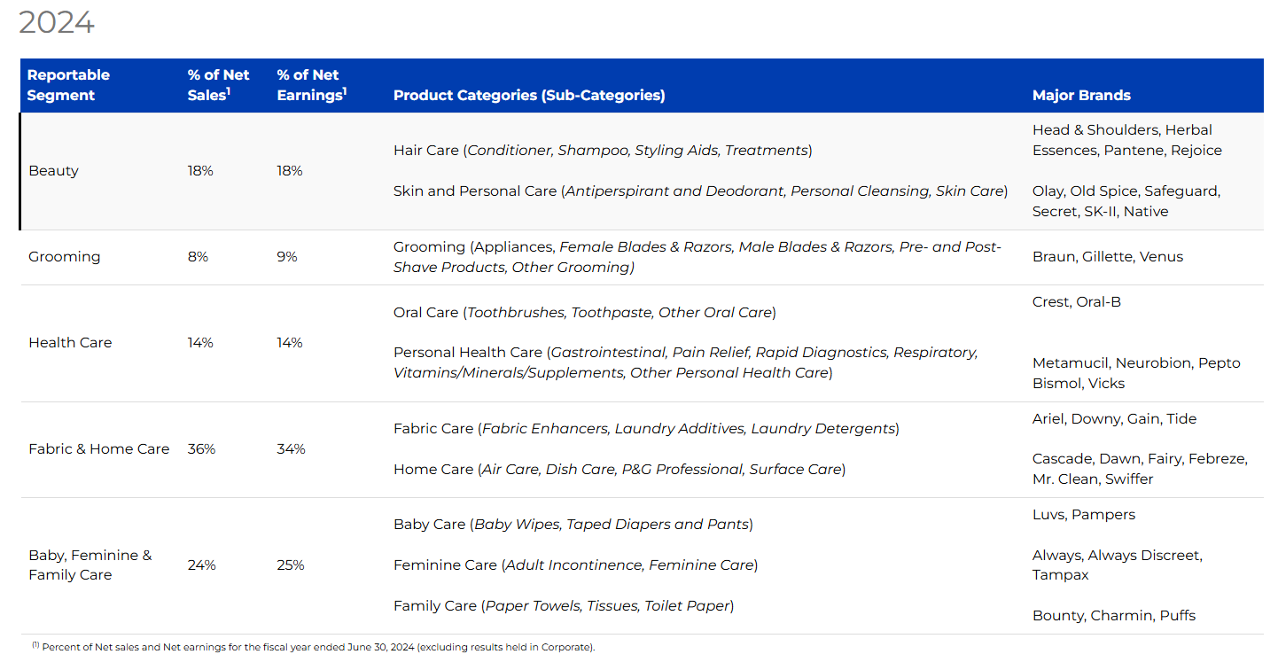
Earnings by Category
Notes:
https://www.pginvestor.com/about-p-g/p-g-at-a-glance/default.aspx

Slide 17
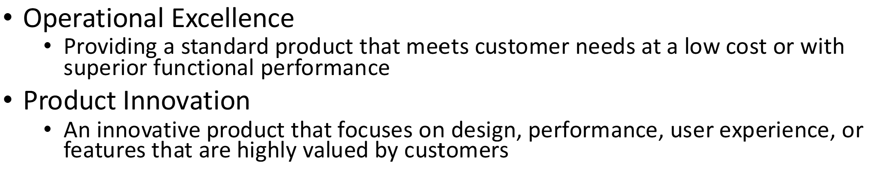
P&G’s Differentiated Value Type
Operational Excellence
Low pricing across products for customer satisfaction
Consistent product performance across multiple categories
Product Innovation
Designing new user experiences for customization
Designing new/better products/packaging to meet customer needs
Notes:
https://www.pginvestor.com/about-p-g/p-g-at-a-glance/default.aspx

Slide 18


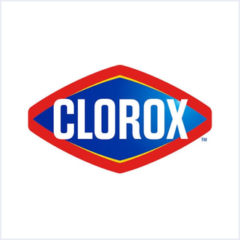
Product Segment | Key Competitor | P&G's Strengths | Competitor's Strengths | P&G's Digital Technology Strengths | Competitor's Digital Technology Strengths
Health Care | Johnson & Johnson | Strong brand portfolio and extensive distribution network. | Diverse product range and significant R&D investment. | Utilizes AI and machine learning for consumer behavior analysis and product innovation. GlobalData | Invests in digital health platforms and data analytics to enhance patient care and product development. GlobalData
Beauty | Unilever | Innovative products and strong market presence. | Extensive global reach and strong sustainability initiatives. | Developed AI-enabled applications like Olay’s Skin Advisor for personalized skincare recommendations. GlobalData | Leverages digital platforms for consumer engagement and employs data analytics for market insights. GlobalData
Grooming | Edgewell Personal Care | High-quality products and strong brand loyalty. | Cost-effective products and strong presence in specific markets. | Implemented digital manufacturing processes to enhance efficiency and product quality. GlobalData | Utilizes e-commerce platforms to reach a broader audience and employs digital marketing strategies. GlobalData
Fabric and Home Care |  | Wide range of trusted brands and strong distribution channels. | Focus on sustainability and strong brand recognition. | Adopts digital supply chain management systems for improved logistics and inventory control. GlobalData | Invests in digital marketing and consumer analytics to drive sales and understand consumer preferences. GlobalData
Baby, Feminine, and Family Care | Kimberly-Clark Corporation | Innovative products and strong market presence. | Strong focus on quality and extensive product range. | Utilizes digital platforms for consumer engagement and employs data analytics for market insights. GlobalData | Leverages digital technologies for product innovation and supply chain optimization.

Slide 19
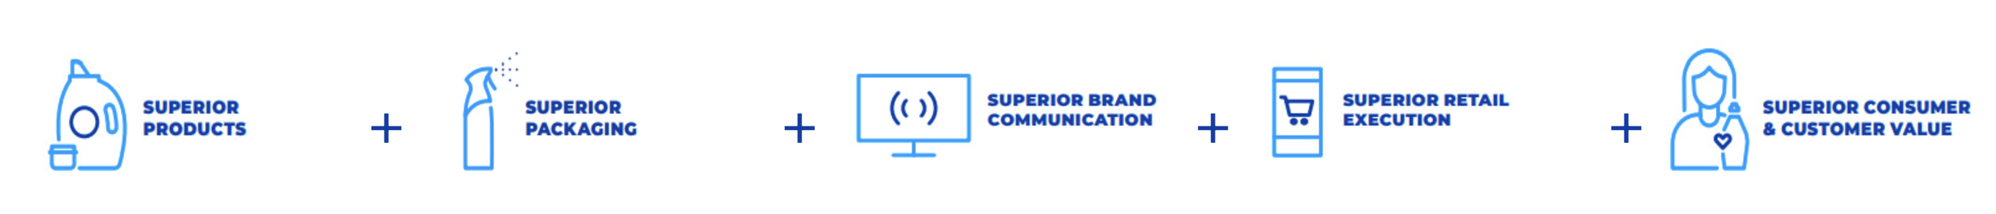
Logic of the Business
P&G’s primary goal is to be the most consumer-centric FMCG company by leveraging digital technologies to deliver personalized products and services, achieve operational excellence, and ensure sustained growth and profitability
P&G have taken a deliberate step to invest in and advance the superiority of products and packages, brand communication, retail execution and consumer & customer value

